Slide 1

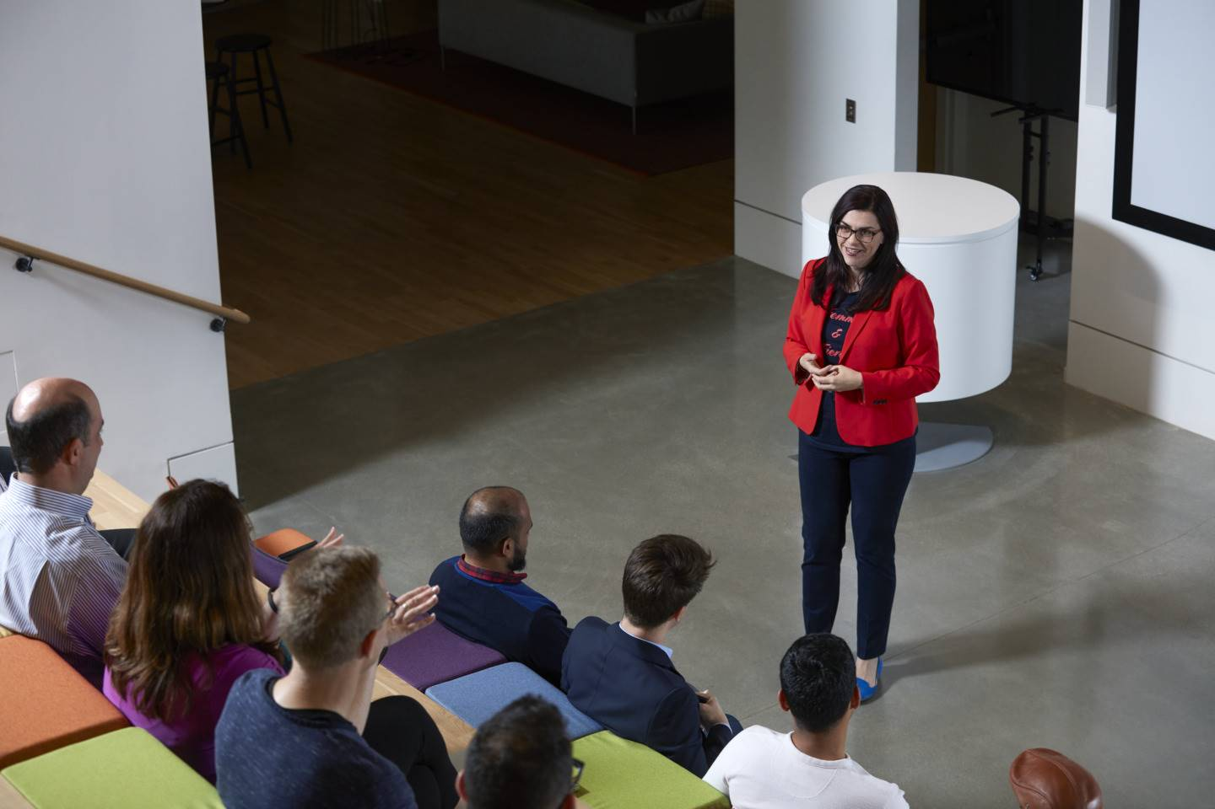
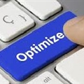





KSH Session Practicalities
Welcome to a new MELA NMSD SL Optimize Knowledge sharing session! Python Upskill for NDO Workshop
Practicalities
1h session
Post your questions on the chat. Questions will be answered at the fly or at the end.
Attendance has been muted.
Cameras have been disabled
Session is being recorded
Find in the Python Upskill for NDO Workshop Degreed Plan the Pathways with the recorded sessions, ppts and materials

Slide 2
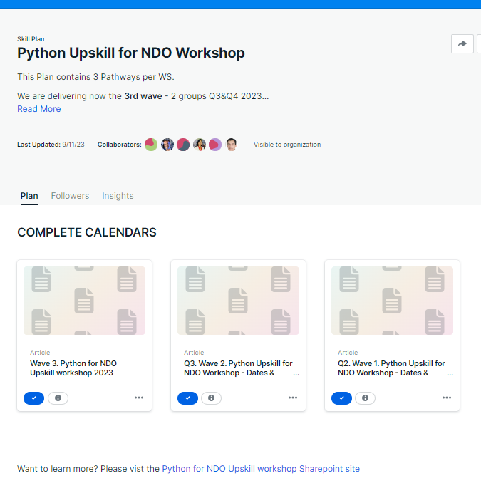
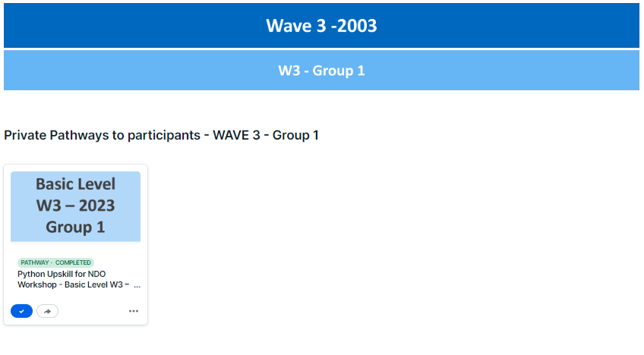
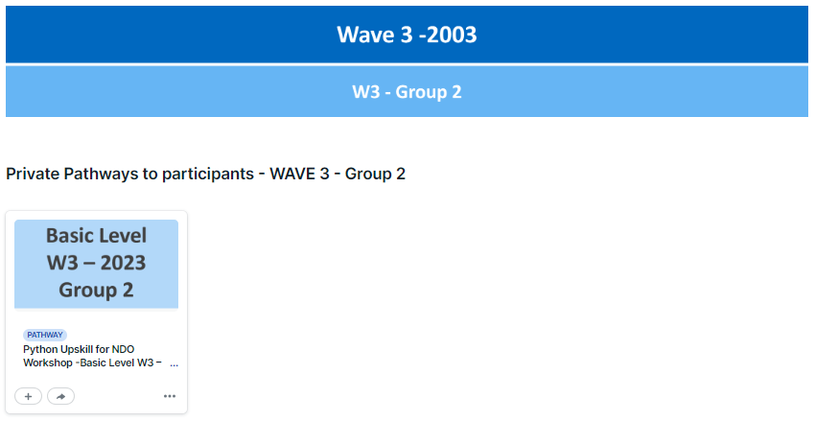
Python Upskill for NDO Workshop Degreed Plan
Pathways
per Level
WS Complete Calendar
SharePoint Site

Slide 3
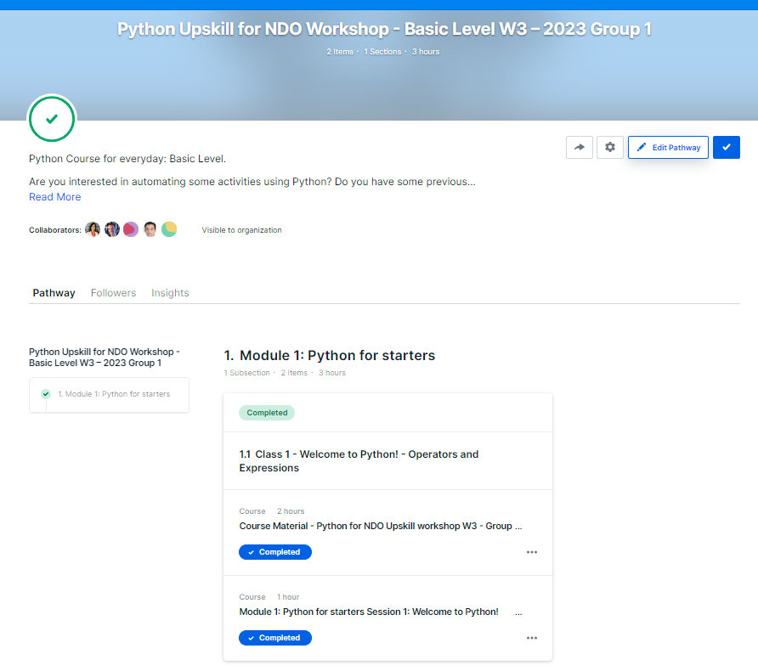
Python Upskill for NDO Workshop Degreed Plan
Pathway
Basic Level
Organized by Class
In the “material” you will access to the SharePoint where you can find the PPT & Files used during the session
In the “video” you will access to Ericsson Play where you can watch the recorded session
In case of issues, doubts or ideas to improve! please contact Ximena Galano

